Slide 1
Stress and Trust
Organisational Behaviour
Dr. Mary Kinahan
Notes:
https://www.youtube.com/watch?v=kgqep0h1tuo

Slide 2

Review of Week 3-5
Content Theories of Motivation
- Maslow; ERG; Herzberg
- McClelland Theory; Theory X and Y
Process Theories of Motivations
- Equity theory; Expectancy theory;
- Goal setting; Self-efficacy
Context Theories of Motivation
- job design e.g., enrichment, rotation etc.
- Job Characteristic model
- Job satisfaction

Slide 3

What is workplace stress?
The UK Health and Safety Executive (HSE) defines work-related stress as:
‘The adverse reaction people have to excessive pressures or other types of demand placed on them at work’. People can become stressed when they feel they don’t have the resources they need (whether physical, financial or emotional) to cope with these demands.
Occupational stress poses a risk to businesses and can result in higher sickness absence, lower staff engagement and reduced productivity.
According to the HSE, 17.9 million working days were lost to stress, anxiety or depression in 2019/20.
CIPD 2021 Workplace Stress

Slide 4

STRESS in ORGANISATIONS
Employers' liability for workplace stress, bullying and harassment continues to be one of the growth areas in Irish employment law.
The obligation on the employer is to identify risk factors and put in place remedial mechanisms, including effective bullying, harassment and grievance policies.
There is no absolute duty on employers to provide a stress free environment in the workplace, rather an employer is expected to conduct their business as a reasonable and prudent employer would.
CIPD Fact Sheet on STRESS

Slide 5
Changing Nature of Contemporary Workplace
Technology
Globalisation
Economic uncertainty
Knowledge as a commodity
Contract work
Greater competition

Slide 6
Studying Workplace Stress
Person factors
Stressors in
Organizational
life
Perception &
Cognition
Strains
Situation factors
Notes:
Stressors: Physical (noise, light) and psychological (role ambiguity, role conflict)
Percpetion and cognition (appraisal process)
Strains: physiological (cardiovascular), psychological (depression, anxiety), behavioral (turnover, absenteeism)
MODERATORS
Person factors: self-esteem, locus of control
Situation factors: social support
6

Slide 7
CIPD Report (2021) Health & Well being
Stress is one of MAIN reasons for short and long-term absences
Overall, nearly four-fifths of respondents report some stress-related absence in their organisation over the last year (2020-2021)
More recognition of stress amongst employees BUT just half of (HR)people professionals who report that their organisation is taking steps to address work-related say its efforts are effective.
the impact of new stressors on people because of the pandemic. These concerns are a severe test of people’s resilience, and employers need to be aware of the personal, as well as work, pressures on people.
Pressure Vs Stress ??

Slide 8

CIPD Report (2021) Health & Well being
The main causes of employee stress include:
Workloads/volume of work. (Work intensification)
Management style.
New work-related demands or challenges due to homeworking as a result of COVID-19.
Non-work factors - relationship or family issues.
COVID-related anxiety, for example fear of contagion in the workplace/commute.
Non-work factors – personal illness or health issues.
Poor work-life balance due to homeworking as a result of COVID-19.
Relationships at work

Slide 9
Impact
Stress
Mental well-being
Lower productivity
Emotions
‘I always feel so guilty; I visit my mother in Hertfordshire every week, and try to stay for a couple of hours. I always have so much to do at home, though, that I never feel relaxed and I think she picks up on this. After about an hour she tells me not to stay, as obviously I need to ‘get on with things’. I feel terrible. I just never feel I spend long enough with her’.

Slide 10

Work intensification
Working hard comprises a time component and an intensity perspective (Burke, Singh & Fiksenbaum, 2010)
Despite recognition, it is very difficult to capture in a measurement
It is argued that work intensity is a stronger predictor of work and well-being outcomes than number of hours worked.
“the process of raising the expected workload of an employee by increasing the amount of tasks to be undertaken or shortening the time allowed to complete those tasks.”

Slide 11
Contributors to intensification
Technological advancements (Green, 2004)
Monitoring of pace and effort
Facilitation of work outside normal hours
Organisational change
Human resource policies
Job insecurity (Burchell et al., 1999)? Not corroborated by Green (2004)
Decline in Union power? Again conflicting evidence.

Slide 12
Is work intensifying?
https://www.ft.com/content/e9835846-d88c-4947-a5ee-33a378ff9f65

Slide 13
Flexible working practices
May have been in some organisations for quite some time but without the title
Often informal arrangements until more recent years and so could be easily reversed (Wilton et al., 2010)
Internal and external factors
Cost (replacements etc.)
Labour market conditions
Perception of family-friendly policies
Dominance of the male model of work
Industry specific challenges (clients etc.)

Slide 14
Do flexible working practices reduce intensification?
Example from practice
London Borough of Merton
Halved sickness absence and improved productivity by introducing flexible working practices as part of a work-life balance pilot project
Compressed working week
Working from home
Career breaks
Job sharing
Special leave
Required shift in management style- focus moved from attendance to output
Significant training required
Requires a flatter structure and more team based work
People Management, 2002; January

Slide 15
Links to health?
Self-scheduling ++
Flexitime
Overtime
Gradual retirement ++
Involuntary part-time
Fixed-term contract
Also linked to spouse’s working practices. One person working flexitime associated with less burnout (Grzywacz, 2008)

Slide 16
Why Bother about Stress?
A recent Mental Health Association of Ireland (MHAI) survey found that 35% of adults claim to have experienced notable levels of stress in the past, while 11% (300,000 people) said that workplace stress interferes with their family lives
The total cost of stress-related illnesses across the EU, according to the most recent survey, is €13 billion (re-training costs, sickness pay, accident and/or illness insurance payouts and recruitment costs)

Slide 17
European Foundation for the Improvement of Living and Working Conditions, 2007
After back-pain, most common health problem in EU is work related stress (~ 30%)
Risk Groups
Health and social services (DK, ES, FI, NL, EU)
Education (DK, ES, FI, NL, EU)
Public administration (FI)
Banking (ES)
Freight transport (FI, NL, EU)
Hotel & restaurant
Policing
http://www.eurofound.europa.eu/ewco/reports/TN0502TR01/TN0502TR01.pdf

Slide 18
Signs of Stress
Work Performance
Conflict and emotional signs
Declining/inconsistent performance.
Uncharacteristic errors.
Loss of motivation/commitment.
Lapses in memory.
Increased time at work.
Lack of holiday planning/usage.
Crying.
Arguments.
Undue sensitivity.
Irritability/moodiness.
Over-reaction to problems.
Personality clashes.

Slide 19
Signs of Stress
Withdrawal
Aggressive behaviour
Arriving late to work.
Leaving early.
Absenteeism.
Reduced social contacts.
Malicious gossip.
Criticism of others.
Bullying or harassment.
Temper outbursts.

Slide 20
Signs of Stress
Other behaviours
Physical signs
Difficulty relaxing.
Increased consumption of alcohol.
Increased smoking.
Lack of interest in appearance/hygiene.
Accidents at home or work.
Nervous stumbling speech.
Sweating.
Tiredness/lethargy.
Upset stomach/flatulence.
Tension headaches.
Rapid weight gain or loss.

Slide 21
Models of Stress
Structural approaches
Demand Control Model (Karasek, 1979)
Demand-Control- Support Model (Johnson and Hall 1988)
Michigan Model (Chaplan et al., 1975)
Person-Environment Fit Model (French et al., 1982)
Warr’s Vitamin Model (Warr, 2009)
Transactional approaches
Dynamic Nature of Stress (Cummings and Cooper, 1979)
Lazarus and Folkman
Cox and MacKay’s transactional model of stress (Cox, 1993)
Effort Reward Imbalance model (Siegrist, 1996)
Notes:
Many different types of models and theories of work stress and it can become condusing. Today I will talk about most influential theories identified by their key characteristics in otder to simplify things. – structure or transactional
Structural approaches focus on the aspects of work (and the interactions between them) that are thought to lead to negative emotional state of stress, and in turn, poor employee wellbeing. There are many factors (you will see in a later model) that can influence stress and well being at work.
Structural models of work did much to further our understanding about how working conditions are linked to employee health. However , it makes sense to assume that stress doesnot end when there is a mismatch between person and environment. Individuals at work react to, respond to, and transact with the work environment (i.e. they do things that change their situation. The dynamic nature of stress was highlighted by cummings and cooper (1979) which forms foundation for later theories.

Slide 22

Other Models of Stress
The Conservation of Resources Theory (Hobfoll, 1989) proposes that the stress response is triggered when individuals perceive that they are losing important resources (such as time, money, or social support) faster than they can replenish them.
This can occur when individuals are faced with high job demands, conflict between work and personal life, or other stressors.
The Person - Environment Fit Theory (Eulberg et al., 1988) suggests that the stress is triggered when there is a poor fit between the characteristics of an individual and the demands of their work environment.
For example, an introverted person may experience stress in a highly social work environment. Research on this theory has included: Person - Job Fit, Person - Organization Fit and Person - Group Fit. The Person - Environment Fit Theory has also been applied to understanding the impact of organizational change and job transitions on employee wellbeing.

Slide 23
DMC/S Models of Stress
Demand Control Model (Karasek, 1979) – Demand x Control
Passive job (low demands – low control) -
high strain job (high demands – low control) -> increased risk of health problems.
low strain job (low demands – high control)
active job (high demands – high control) -> healthiest as control is important -> provides better opportunities to deal better with demands faced, and we have basic human need for control
Demand-Control- Support Model (Johnson and Hall 1988)
Expanded on DMC model to include social support
high levels of social support act as a BUFFER against negative effects of work demands (similar effect as control above)
Thus if a job has similar demands –> job with higher levels of social support = more healthy.
Notes:
The demand control model (Karasek, 1979) was build around two particular important features of the work environment. Demands – relate to the amount of work that a person does but also include factors such as time pressures and the amount of mental and physical effort involved in the job. Control in this model includes two components – skill discretion – the extent to which the job allows employees to use their skills and capabilities and decision latitiude – the amount of control the employee has over their suitation. By combining these two dimension – there are four categories.
The model was expanded by Johnson and hall 1988 to include social support (Demand –control-support model )

Slide 24
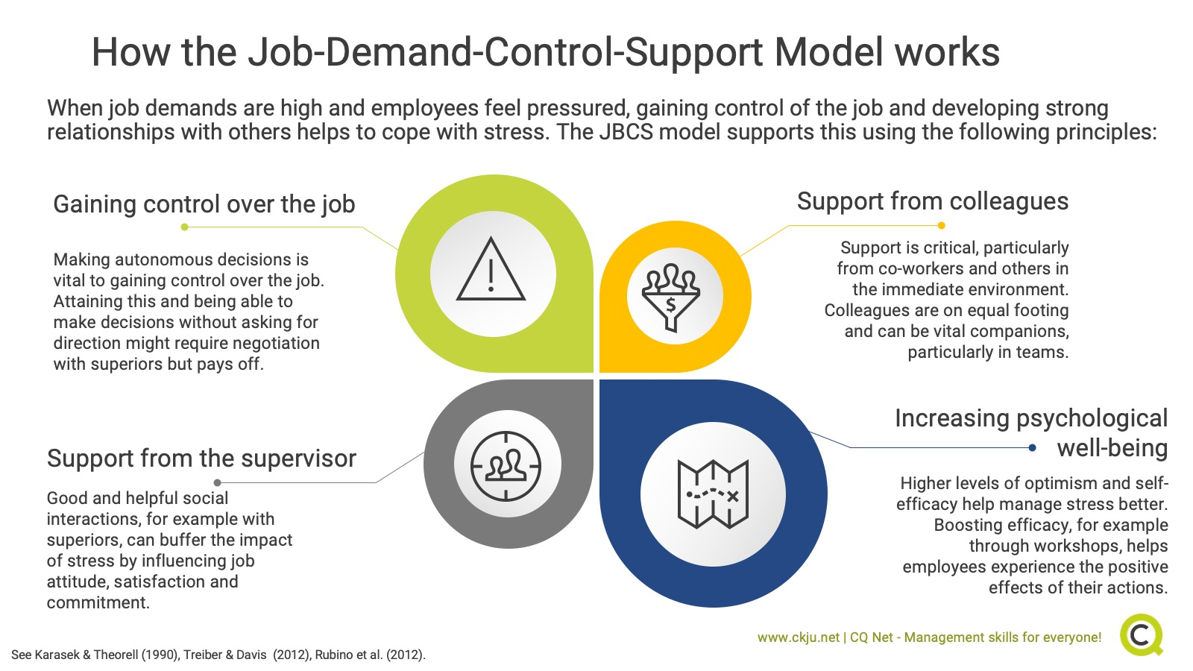

Slide 25
Dual Processes of the JD-R model
Health Impairment Process
Workload
+
+
Job
Demands
Burnout
Health
Problems
Emotional
demands
-
-
Autonomy
Performance
Organizational
Commitment
Job
Resources
+
Engagement
+
Social
Support
Motivational Process

Slide 26

Transactional Models of Stress
Cox and MacKay’s transactional model of stress (Cox, 1993)
Adds to idea of Lazarus and Folkman (propose that individual evaluates the extent to which situation/event pose a thread to them/gain how they will cope) with 5 stages:
The work environment places some demands on the individual
The individual evaluates/appraises these demands in relation to their coping abilities
If there is a mismatch/imbalance at 2, then individual experience negative emotions (anxiety) and physical changes (raised blood pressure) -> results a coping response
There are outcomes of the coping response (e.g., person may be feeling less anxious or even more anxious)
The person appraises the effectiveness of the action taken
Effort Reward Imbalance model (Siegrist, 1996)
Emphasises the importance of the balance of two factors – perceived efforts and rewards.
Negative emotions are experienced when an employee perceives that their efforts aren’t reciprocated -> stress happens
Some employees over commit hoping to eventually gain reward and recognition.

Slide 27
Solutions to Stress (CIPD 2021)
Developing an organisational framework e.g., The Mental Health at Work
Based on the Thriving at work review, it has six standards to achieving better mental health outcomes for employees:
Prioritise mental health in the workplace by developing and delivering a systematic programme of activity.
Proactively ensure work design and organisational culture drive positive mental health outcomes.
Promote an open culture around mental health.
Increase organisational confidence and capability
Provide mental health tools and support.
Increase transparency and accountability through internal and external reporting.

Slide 28
Solutions to Stress (CIPD 2021)
Developing an organisational framework
The Uks HSE(Health and Safety) lists six main areas of work design which can affect stress levels, which need to be managed properly:
Demands: for example, workload and the working environment.
Control: for example. how much say someone has over their job.
Support: for example, level of supervision and resources available to do the job.
Relationships: for example. promoting positive working to help prevent conflict.
Role: for example, making sure people understand their role and how it fits in the
organisation.
Change: for example, how organisational change is managed and communicated.

Slide 29

Solutions to Stress (CIPD 2021)
ORGANISATIONAL SOLUTIONS
Employee assistance programme.
Staff surveys and/or focus groups to identify causes.
Flexible working options/improved work–life balance.
Risk assessments/stress audits.
Training aimed at building personal resilience (such as coping techniques, mindfulness).
Training for line managers to manage stress.
Involvement of occupational health specialists.
Written stress policy/guidance.
Stress management training for the whole workforce.

Slide 30

Solutions to Stress (CIPD 2021)
Prevention
To help prevent workplace stress:
Carry out a stress risk assessment, and then allocate resources to reduce or eliminate the sources of stress.
Give people adequate training and support to do their jobs well.
Increase support for staff during periods of change and uncertainty.
Train line managers to identify potential causes of stress in their teams and manage people, and workloads, effectively.
Increase support for staff during periods of change and uncertainty, particularly important during the ongoing uncertainty caused by the pandemic.

Slide 31
Solutions to Stress (CIPD 2021)
Early Intervention
Spotting and addressing early signs of an issue can prevent it escalating.
Line Managers are essential to spotting possible issues with many org developing different toolkits for managers (communication)
Employers should invest in:
Developing the people management skills and confidence of managers so they can have sensitive conversations with staff.
Developing a supportive work culture to encourage staff to discuss and seek support when experiencing stress.
Providing, and signposting to, sources of support, for example a counselling service, employee assistance programme and charities.

Slide 32
Solutions to Stress (CIPD 2021)
The Role of LMs – 61% of organisations train their managers to help with stress
Line Managers – best placed to know demands of TM, personal needs and circumstances, and identify possible triggers of stress. Often first point of contact. So LMs need to
Get to know your team better.
Lead by example to promote healthy working habits.
Review workloads, duties and responsibilities.
Reflect on your management style.
Discourage ‘presenteeism’ in your team.
Manage the mental health of your team while remote working.

Slide 33
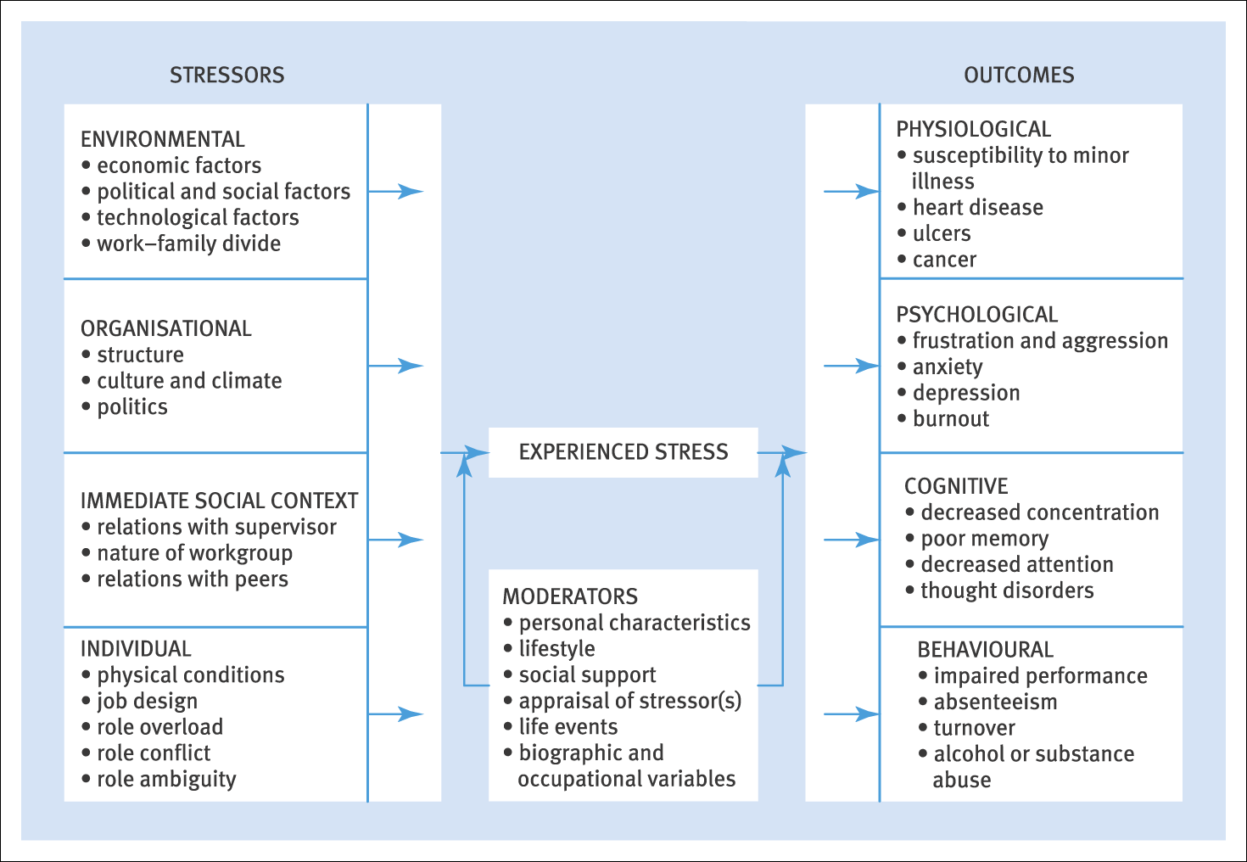
A Working Model of Stress Rollinson (2008)

Slide 34
Assessing consequences and costs:
The measures most frequently used to examine health and well being at work can be grouped into four groups
Organisational Measures
Psychological Measures
Physiological Measures
Measures of health-related beahviours

Slide 35
Organisational Measures
Organisational measures include absence levels, various measures of job performance, accidents and near miss incidents and actual staff turnover.
Absenteeism/Presenteeism is one of the obvious costs of stress to employers.
Turnover has been shown to be linked to working conditions in q number of studies (see Bond et al., 2006). This can be quite expensive.
Organisational measures are often thought to be a good measure of work stress because the data are ‘objective’ and are value to the organisation. If absence and turnover rates are reduced, cost savings can be calculated.
Notes:
Absence – UK health and and safety executive 2007 which estimated that self-reported work related stress, depression or anxiety account for 10.5 m reported lost working dats per year in Britain. SELF REPORTED -> so could be higher. Presenteeism is even more problematic and harder to measure People go to work but less productive either due to reduced commitment, motivation satisfaction or due to health provlems.
Turnover – is linked to working conditions, very expensive especiall when companies invest in training, development etc.

Slide 36
Psychological and physical health Measures
Psychological data can also be classified as organisational measure: known as individual-organisation interface.
Physical Health measures – Morbidity, heart disease, strokes, insuries, suicide and cancer, chronic liver disease and bronchial complaints.
Musculoskeleton issues.
Problem with these outcome measures is that show impact of stress AFTER problem arises.
There are many health and well being self-reports.
General Health Questionnaire – measures symptoms of anxiety, depression, social dysfunction and loss of confident.
Maslach Burnout Inventory (Maslach and Jackson 1981) identified three subscales of burnout
Emotional exhaustion – feelings of being emotionally overstretched and exhausted by work
Depersonalisation – an unfeeling and impersonal response to clients
Personal accomplishment – Feelings of competence and successful achievement at work

Slide 37
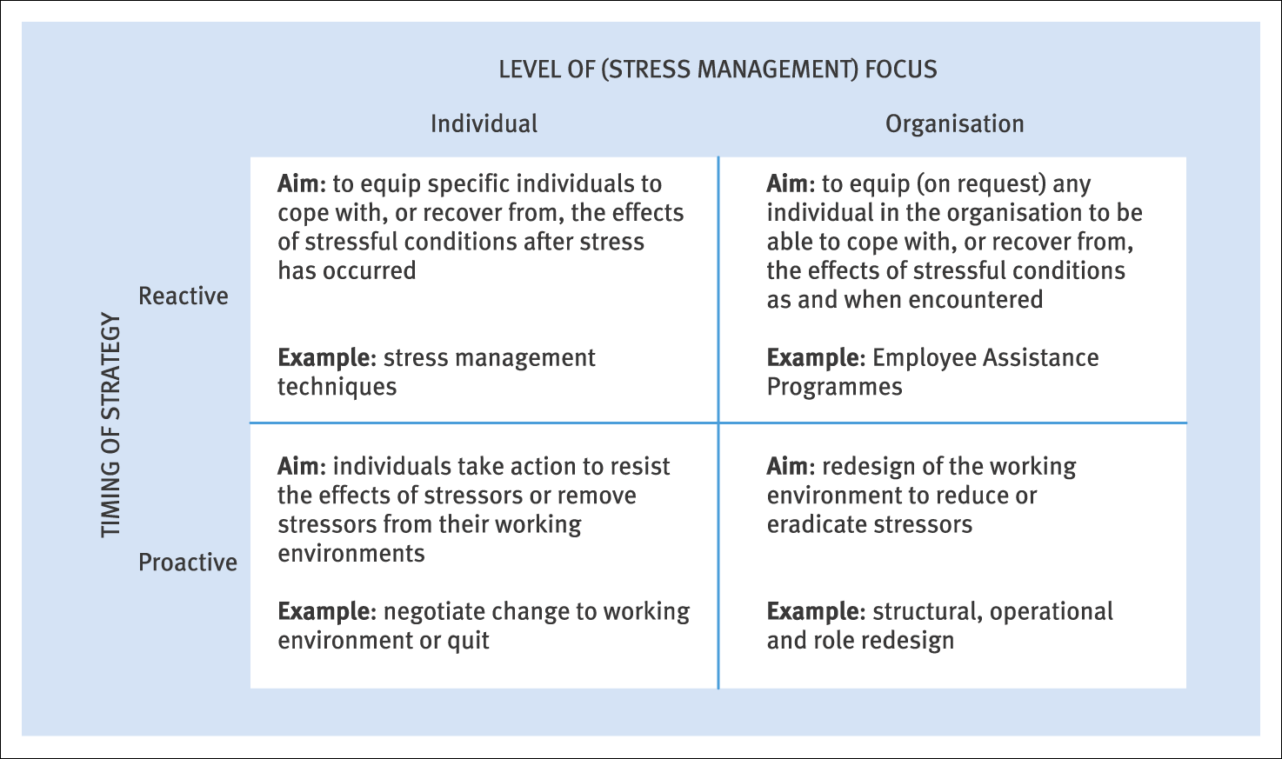
Interventions/Managing Stress Rollinson (2008)

Slide 38
Downsizing Survivor Syndrome
Organisational change e.g., downsizing, restructuring, de-layering, and outsourcing) is a powerful force in organisational development and consequently can result in negative consequences for staff. IF not handled properly.
Survivor Syndrome is seen as a major consequence of this, and includes emotional, psychological, and organisational repercussions who ‘survive’ redundancies.
Effects include lower staff morale due to impaired and reduced social networks, increased workload, lack of trust in organisation, loss of social support, and grief for lost members of staff, guilt for surviving and fear for the future.
Noer (1993) argues that those left behind are often more susceptible to stress than those that leave.
Recommendation: COMMUNICATION – rarely such consequences when change is clearly communication maintaining trust and commitment to organisation.

Slide 39
PREPARING FOR CHANGE
MANAGING CHANGE
REINFORCING CHANGE
Before Change
Serves as a catalyst for change
During Change
Facilitate the discussions about the change and its content with all stakeholders
Post-Change
Help employees to break from the past and adapt a new culture
Helps the organisation build a capacity for change
Ensure project team has necessary skills, training
Plan change process with sponsors
Coach Sponsor
Lead by example by doing it first within the HR function
Coach leaders through the change
Acts as a mentor/coach to employees to help them understand change as it affects their lives
Emphasise “what is in it” for them and address concerns
Strike a balance between the business and employees
Communicate,
Sustain the momentum
Internationalisation of new behaviour/way
Recognise and celebrate success
Build on the change
Notes:
Model the change; Communicate the change; Engage others to participate; help others break from the past; creating a supportive environment
https://hbr.org/2005/05/your-companys-secret-change-agents

Slide 40
Building organisations capacity to embrace and manage change
Awareness
Understanding
Internalisation
Translation
Commitment
Significant involvement Needed at these stages
Commitment
Information with some involvement is sufficient at these stages
Notes:
Awareness of desired behaviour; “yeah I saw the memo”
Understanding of change direction; “I understand where we need to go”
translation to the work setting; “I know how we need to do out jobs differently “
commitment to personal change; “Ok I’m ready to do it the new way”
internalisation of new behaviour: “This is the way we do things here”

Slide 41
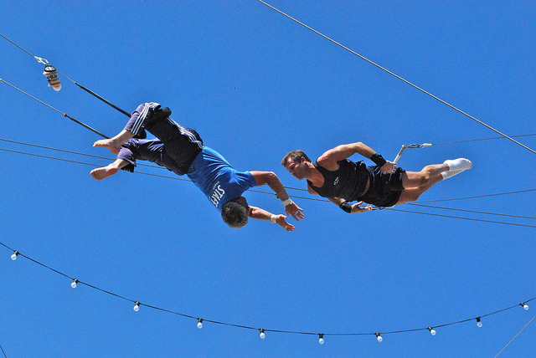
What is Trust?
Who do you trust and why?

Slide 42
Trust in an Organisational Context
Trust is widely accepted as a fundamental component of all human social interactions
Trust research in an organisational context has increased significantly in the last twenty years
Is studied from a number of different perspectives
Behavioural Economics, Marketing, Sociology, Management, Psychology
Is studied at a number of levels
Inter-personal , groups/teams, organisations, technology
Perspective of this lecture
HRM, organisational psychology, inter-personal trust

Slide 43
Trust as a Behavioural Choice
Rational
Calculative/instrumental
Cognitive
Economic exchange
Extrinsic economic value
Often formal, contracted, specific
Monitoring/control
Less risk
Relational
Social
Affective / emotional
Social exchange
Intrinsic subjective benefits
Usually informal, less specific, voluntary
Less control
No guarantee of reciprocity
Behaviour
Reliance on another person
Disclosure of information to another person

Slide 44
Trust as a Psychological State
“the willingness of a party to be vulnerable to the actions
of another party based on the expectation that the other will perform a particular action important to the trustor, irrespective of the ability to monitor or control that other party”
(Mayer, Davis & Schoorman, 1995, p712)
“a psychological state comprising the intention to accept vulnerability based upon positive expectations of the intentions or behaviour of another”
(Rousseau, Sitkin, Burt & Camerer ,1998, p395)

Slide 45

The Nature of Trust
Trust
A psychological state, willingness to be vulnerable
Trustworthiness
Trustee qualities perceived by the trustor
Propensity to Trust
A dispositional trait, a general willingness to trust
Trustor
Trustee
Relationship
Develops over time
Depends on context
Involves risk
Notes:
Although closely related, trust is not……..
Co-operation
Confidence
Predictability
Trust involves risk for the trustor:
Outcome is important for the trustor
Outcome is outside the control of the trustor
Outcome is within the control of the trustee
Outcome is potentially negative, so the trustor is vulnerable

Slide 46
Why is Workplace Trust Important?
Trust has been shown to influence:
Constructive workplace behaviours and attitudes (Dirks & Ferrin, 2001)
Higher levels of co-operation (Morgan & Hunt, 2004)
Greater exchange of knowledge and information (Collins & Smith, 2006)
Reduction in transaction costs (Dyer & Chu, 2003)
Successful change management (Albrecht & Travaglione, 2003)
Superior levels of performance (Dirks, 2000)
Trust augments social capital (Kramer, 1999)
Mitigating transaction costs through enhanced collaboration and cooperation
Increasing sociability of employees which in turn can lead to more altruistic and prosocial behaviours
Facilitating deference to those in authority which implies that superiors do not have to constantly justify their actions and behaviours to their subordinates

Slide 47
HRM and Trust
Trust is influenced by the context in which it operates
in organisations HRM policies are a key factor in shaping the environment and creating guiding principles and rules for behaviour
HRM emphasises the facilitation of positive workplace behaviours to encourage employee commitment and performance
trust is factor which enables effective workplace relationships that support organisational performance and employee engagement
So HRM and trust are intertwined:
HRM policy choices and practices can influence levels of trust in an organisation
Levels of trust can influence HRM policy choices and the effectiveness of HRM practices
Trust and HRM is an under-explored area of research

Slide 48

HRM and Trust
HRM involves two aspects of trust:
Systems trust
Employees and line managers must view the HR systems (the processes, procedures, practices) as fair, consistent, non threatening
Interpersonal trust
Employee perceptions of HRM processes are also influenced by trustworthiness perceptions of both their direct manager and of the designers of the HRM systems (the HR professionals)

Slide 49
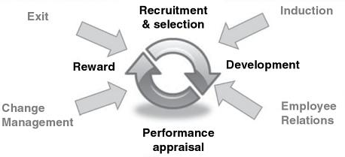

Trust is a factor throughout the HRM cycle
TRUST
Adapted from
Skinner, D., & Searle, R. (2011). Trust and human resource management. Edward Elgar Publishing, p6

Slide 50
Restoring Trust after Downsizing
Employees need to believe:
they can do the job (confidence);
(2) they believe management will reward their performance (trust),
and
(3) the outcomes will satisfy them (satisfaction).
Green, T. & Hayes, M. (1993) The Belief System: the Secret of Motivation and Improved Performance: Beechwood Press
PLAN
COMMUNICATE
LISTEN
MAINTAIN CULTURE OF TRUST
DEVELOP SURVIVOR’S SKILLS
Shaw, R. (1997). Trust in the Balance: San Francisco: Jossey-Bass

Slide 51

Thank you for listening

